Slide 1

Garbage Classification
8.20.2021

Slide 2
Garbage classification
In Problem Set #1 part(d), we solved the problem of Garbage Classification using SGD and ANN with simple dense layers.
But, the results of training were poor (the accuracy is below 20%).
Here, we discuss about Convolution Neural Network(CNN) and Image augmentation. They are popular and strong methods for image classification.

Slide 3
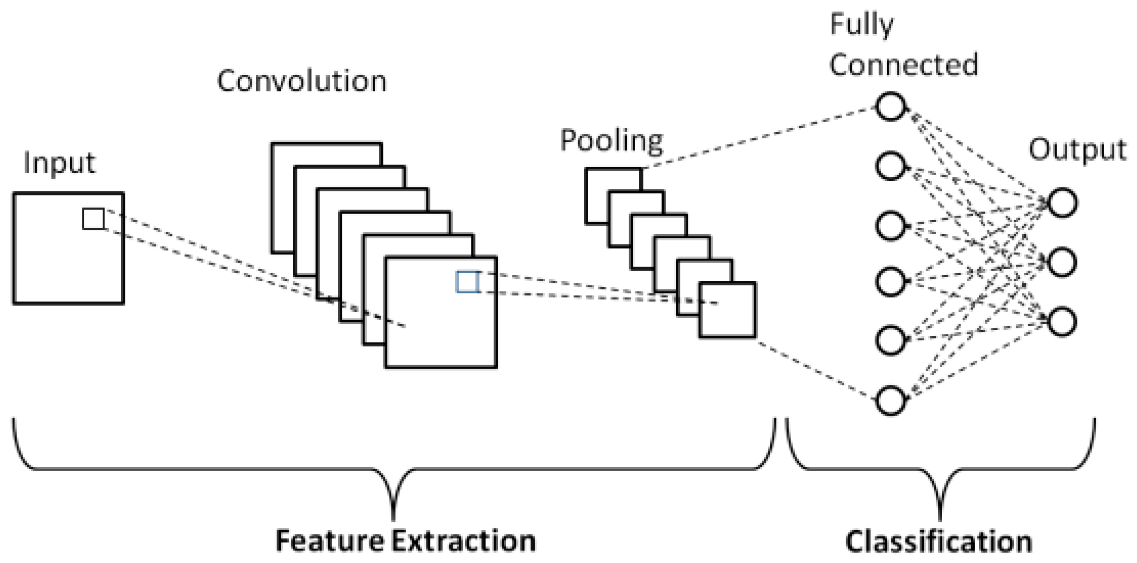
Convolution Neural Network (CNN)
CNN is composed of three types of layers : Convolution layers, Pooling layers, and dense layers.
The convolution layers and pooling layers perform feature extraction.
Then, dense layers map the extracted features into final output.

Slide 4
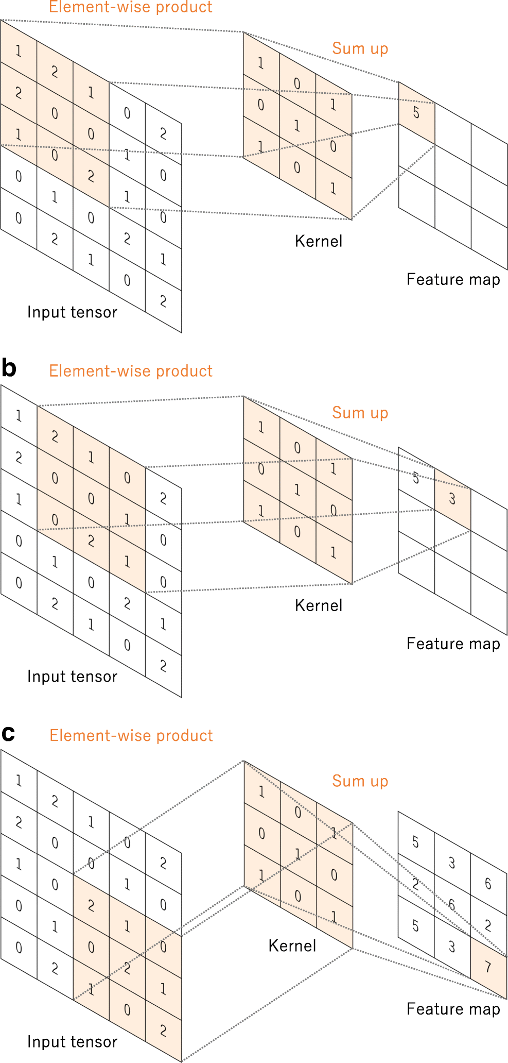
Convolution layer (1)
Convolution means linear operation used for feature extraction, where a small array of numbers, called a kernel, is applied across the input.
There are three parameters for convolution layers: kernel size, stride, and padding.
1. Kernel size : The example shows the convolution operation with a kernel size of 3 X 3. (typically 3 X 3, but sometime 5 X 5, 7 X 7) The size determines the depth of output feature maps.
2. Stride : the number of pixels shifts over the input matrix. (the stride of the example is 1) When the stride is 1, then we move the filters to 1 pixel at time.

Slide 5
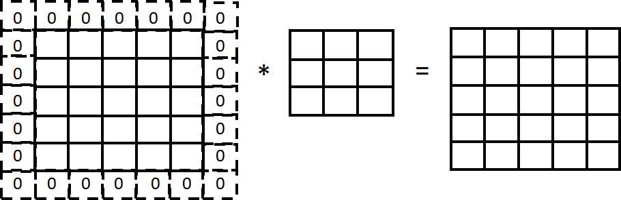
Convolution layer (2)
3. Padding : When kernels cannot fit perfectly fit the input image, padding is a technique to address this issue, where rows and columns of zeros are added on each side of the input. Then, it can fit the center of a kernel on the outermost element and keep the same in-plane dimension through the convolution operation.
Without padding, each successive feature map would get smaller after the convolution operation.

Slide 6
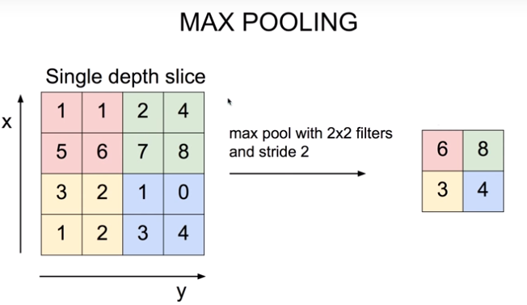
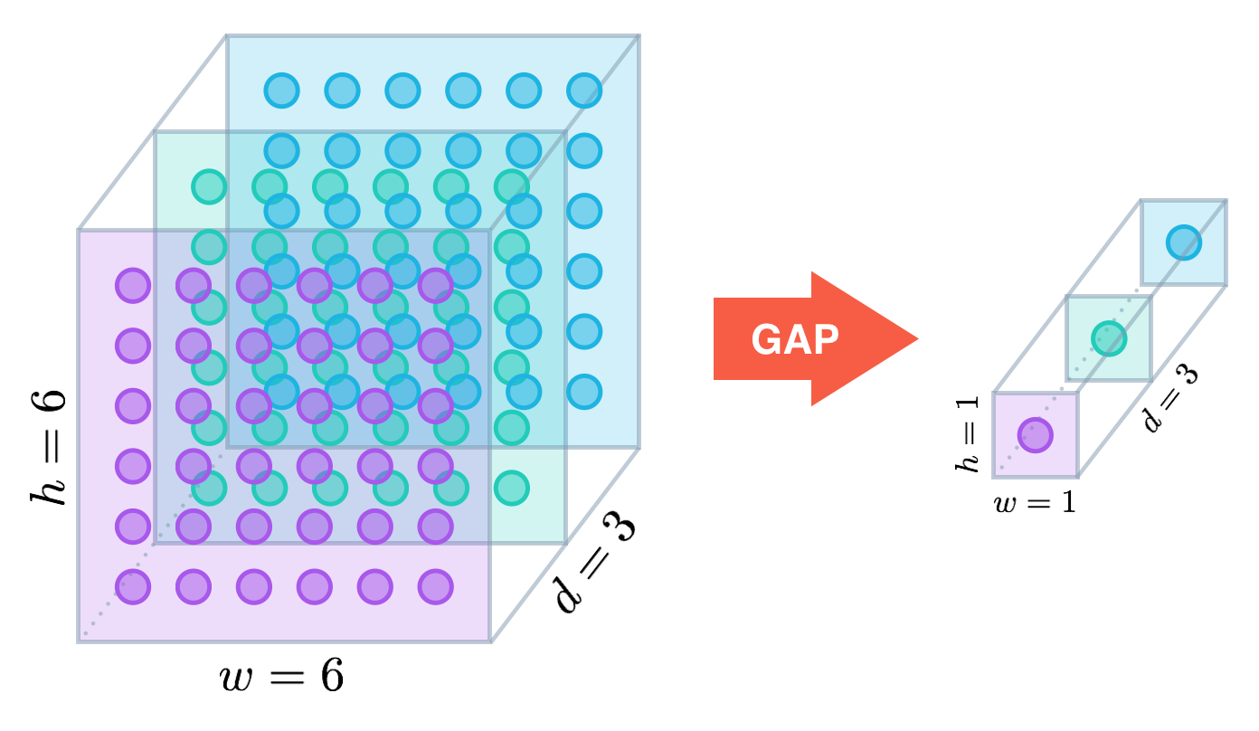
Pooling layer
A pooling layer provides a typical downsampling operation which reduces the in-plane dimensionality of the feature maps in order to introduce a translation invariance to small shifts and distortions.
It can decrease the number of subsequent learnable parameters.
There are two types of pooling operation.
1. Max pooling : extracting a maximum value in a filter.
2. Global average pooling : computing the mean of each entire feature map.
Averaging for each feature map

Slide 7
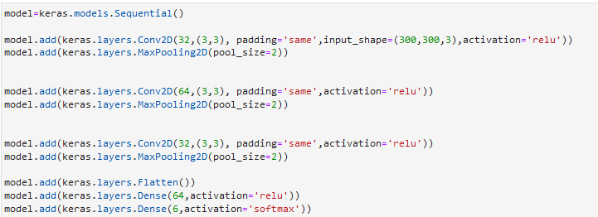
Build CNN
First, build three layers which are composed of a convolution layer for 2D (Conv2D) with an activation function of ReLU and a Max pooling layer for 2D (MaxPooling2D)
The convolution layers have 32 kernels with size of 3 X 3 and 1 stride (default) and use padding. And the max pooling layer have 2 X 2 size of filter.
Then, add a flatten layer and add a dense layer with 64 neurons and an activation function of ReLU.
Finally, add a dense layer with 6 neurons and an activation function of softmax for output.

Slide 8
Build CNN
We use “callbacks_list” which save the model with a highest validation accuracy.
(Make a directory named “CNN” to save the model)
Then, compiling the model using sparse categorical crossentropy for loss and adam optimizer.

Slide 9

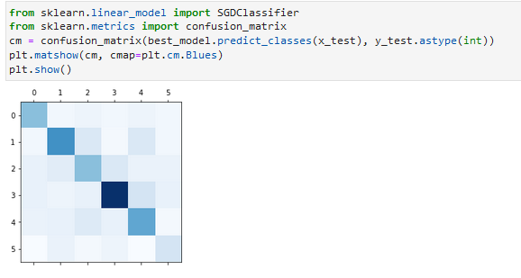
Result of CNN
After training is over, load the model with a highest validation accuracy.
While the validation accuracy of ANN with simple dense layers doesn’t exceed 20 % in Homework #4 (d), This CNN model have the validation accuracy of 62%
Drawing a confusion matrix using the best model

Slide 10
Image Data Augmentation
Data augmentation is a strategy used to increase the amount of data by using techniques like cropping, padding, flipping, etc.
Data augmentation makes the model more robust to slight variations, and hence prevents the model from overfitting.
We use a Keras API for image data preprocessing.
import a module of “keras.preprocessing.image “

Slide 11
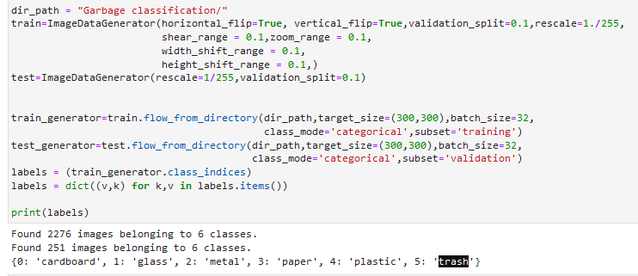
Image Data Augmentation
There are various methods for image data augmentation.
We will use
(1) shear
(2) zoom
(3) width and height shifting
(4) horizontal and vertical flip

Slide 12
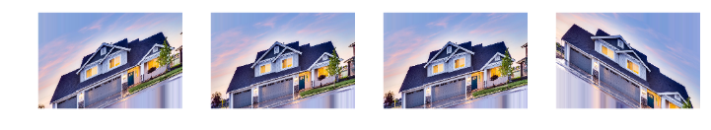
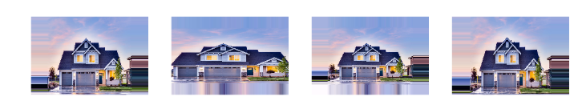
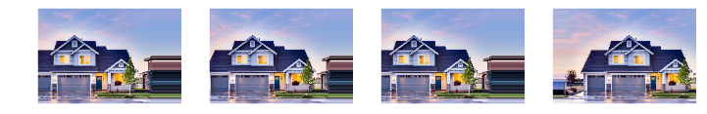
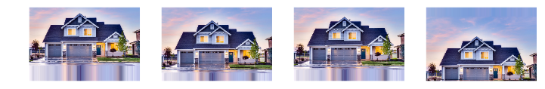
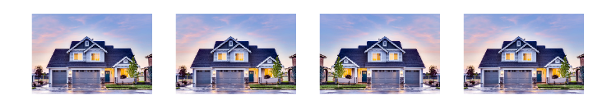
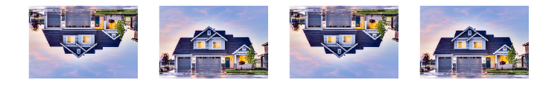
(1) shear
(2) Zoom
(3) width &
height shifting
(4) horizontal &
vertical flip

Slide 13
Image Data Augmentation
Making image data generator for train and test dataset

Slide 14
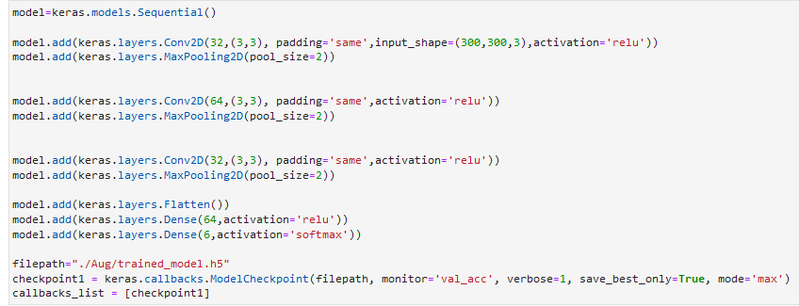
CNN with data augmentation
Build CNN and compiling the same to the previous CNN model.

Slide 15
CNN with data augmentation
To train, we use “fit_generator” instead of “fit” due to image data generator.

Slide 16

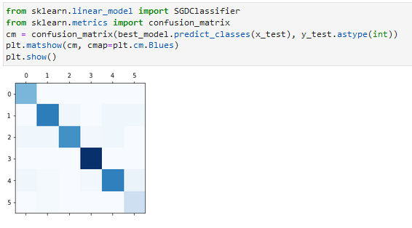
Result of CNN with data augmentation
After training is over, load the model with a highest validation accuracy.
The model have the validation accuracy of 76%
A Confusion matrix shows a result of improved classification.

